Slide 1

Digital Interaction Final Year Project
Project Title: A Wireless 3D Embedded RTOS Human Computer Interface
Name: Ciarán O’Donnell
Student ID: 15414048
Project Supervisor: Derek Molloy

Slide 2








What is A Wireless 3D Embedded RTOS Human Computer Interface?
Wireless 3D
The device should be connected to the computer wirelessly and communicate 3-Dimensional information
Human Computer Interface
(HCI) is any device that allows a person to give input or take output from a computer.
Embedded RTOS (Real Time Operating System)
This means the device must work on an embedded device that operates in real-time.

Slide 3
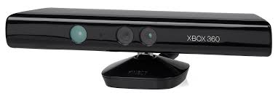
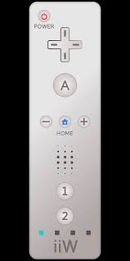
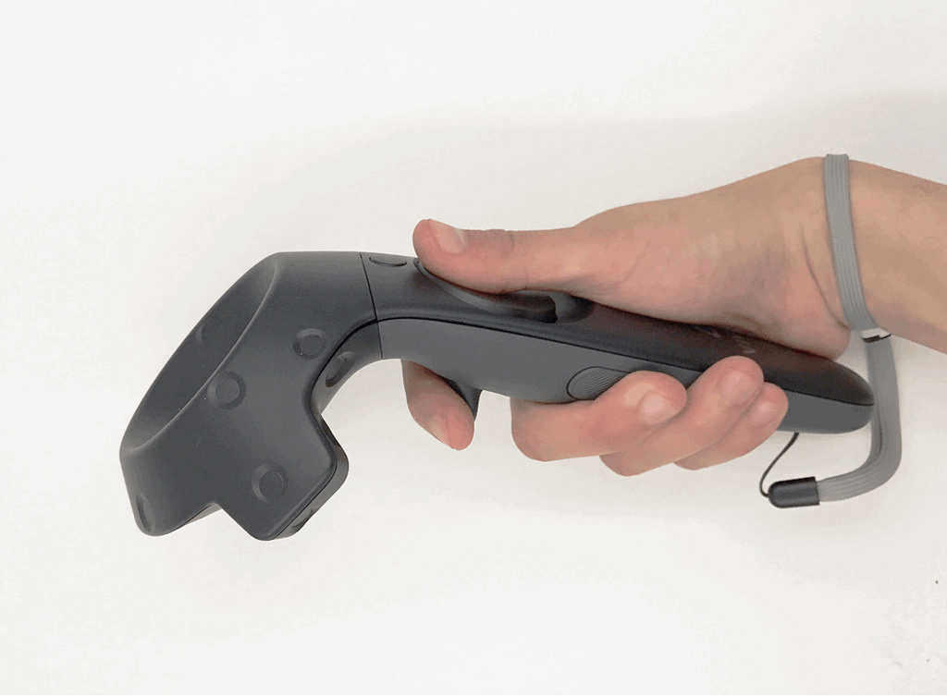
What is A Wireless 3D Embedded RTOS Human Computer Interface?
Some similar devices include:
Nintendo Wii Controller
HTC Vive Controller
Xbox Kinect Camera
However these devices have many constraints due to their proprietary nature.
[1]
[3]
[2]

Slide 4
What are the engineering problems to be tackled?
3D Information
How will 3D information be gathered and stored by the device?
Wireless Communication
How will the device communicate the necessary information wirelessly?
RTOS Programming
Programming for a real-time device is more difficult and care must be taken to write extremely robust and efficient code.
Interfacing with a Computer
The device must be able to communicate with the computer in a way which the computer operating system can understand.

Slide 5





3-Dimensional Information Solutions
Distance/Visual Sensor tracking
Distance sensors or visual sensors can be used to track a device throughout space.
The Nintendo Wii, HTC Vive, and Xbox Kinect all use this technology.
Gyroscope & Accelerometer Tracking
Gyroscopes and accelerometers can be used to track positional and movement data in space i.e. device facing up down left or right.
Nintendo Wii and most modern Mobile phones use this technology.
[4]

Slide 6
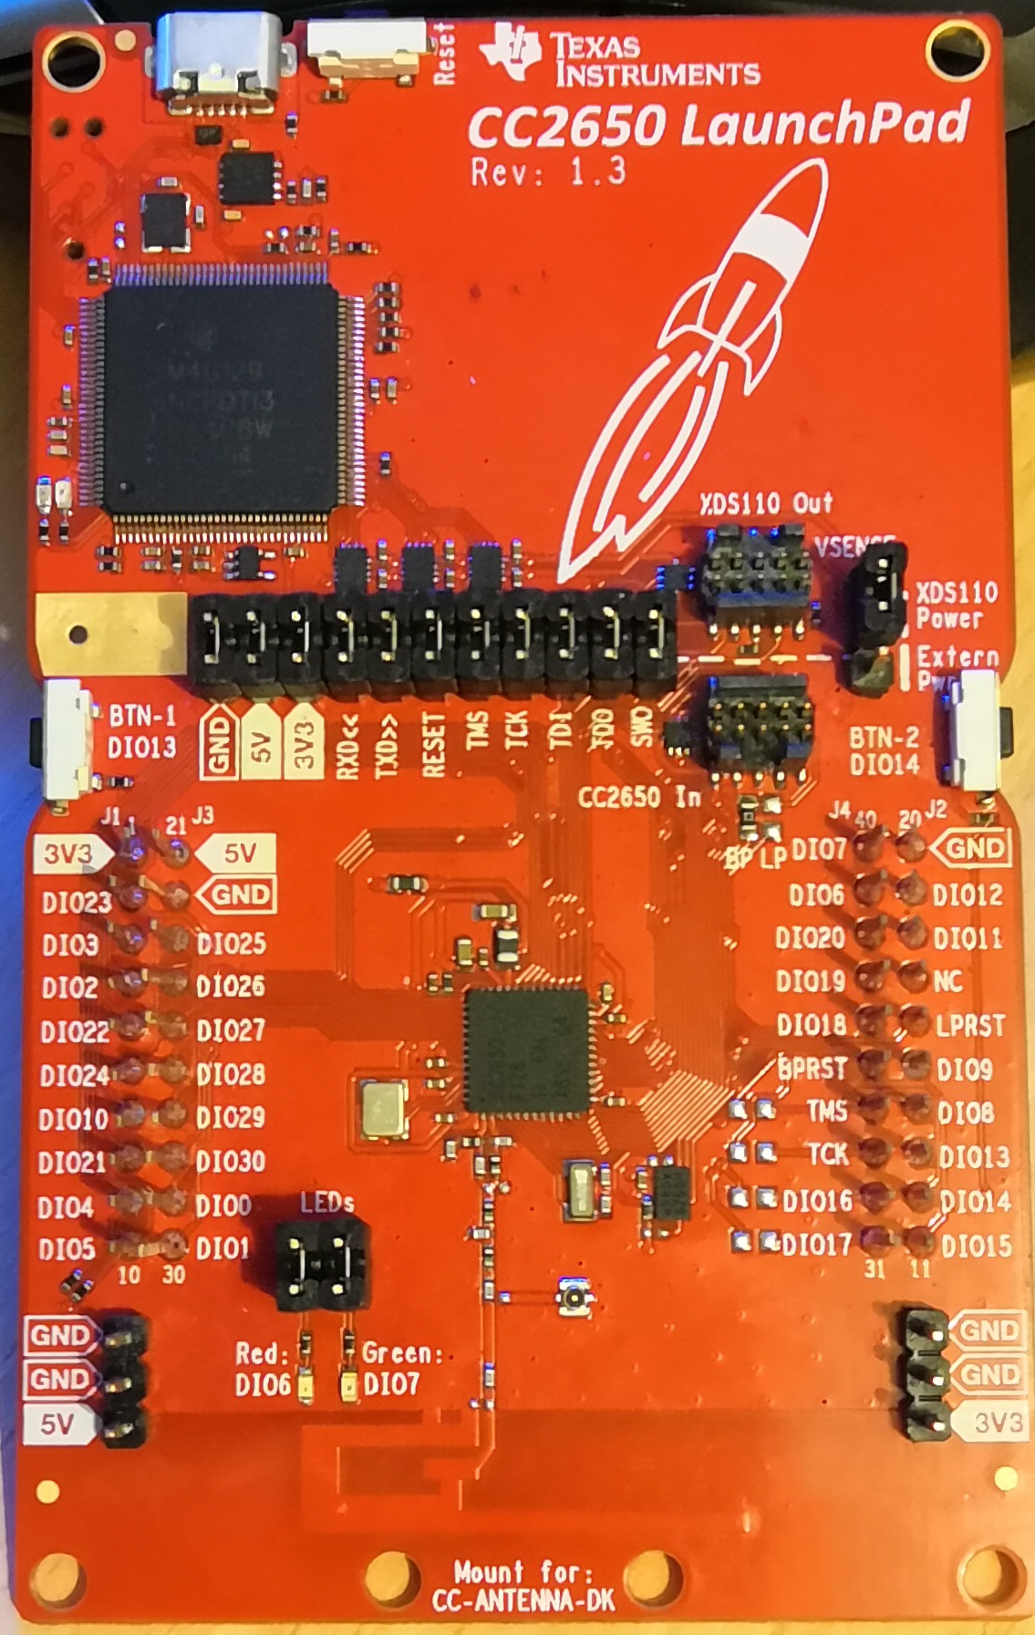
Wireless Communication Solutions
The device must communicate wirelessly. There are many possible wireless communication standards that could be implemented for this purpose.
WiFi
Bluetooth
Zigbee
Plus many more
This was one of the major deciding factors in the embedded system chosen
Chosen System:
TI SimpleLink CC2650.

Slide 7
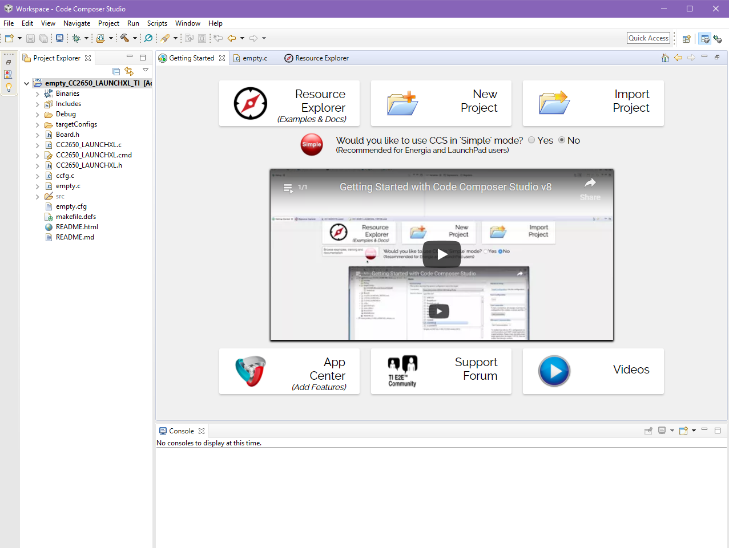
Real-Time Operating System Information
A real time operating system is a system that every function has a pre-determined amount of time to complete.
Advantages:
Accurate
Efficient
Disadvantages:
low-level code
Code must be efficient
The chosen board already discussed was also chosen due to the fact it can use TI – RTOS. A real-time programming language with a lot of open resources.
TI – RTOS has the advantage of having plenty of resources available within its IDE – Code Composer Studio

Slide 8

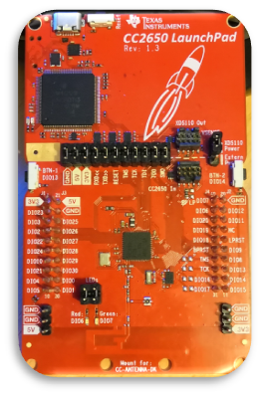

Interfacing with the Computer
The device must be able to communicate with a desktop pc.
Windows will be the operating system designed for as it is the system my current setup uses.
The SimpleLink devices already discussed can be deployed in pairs to communicate wirelessly between and then one communicates to PC.

Slide 9
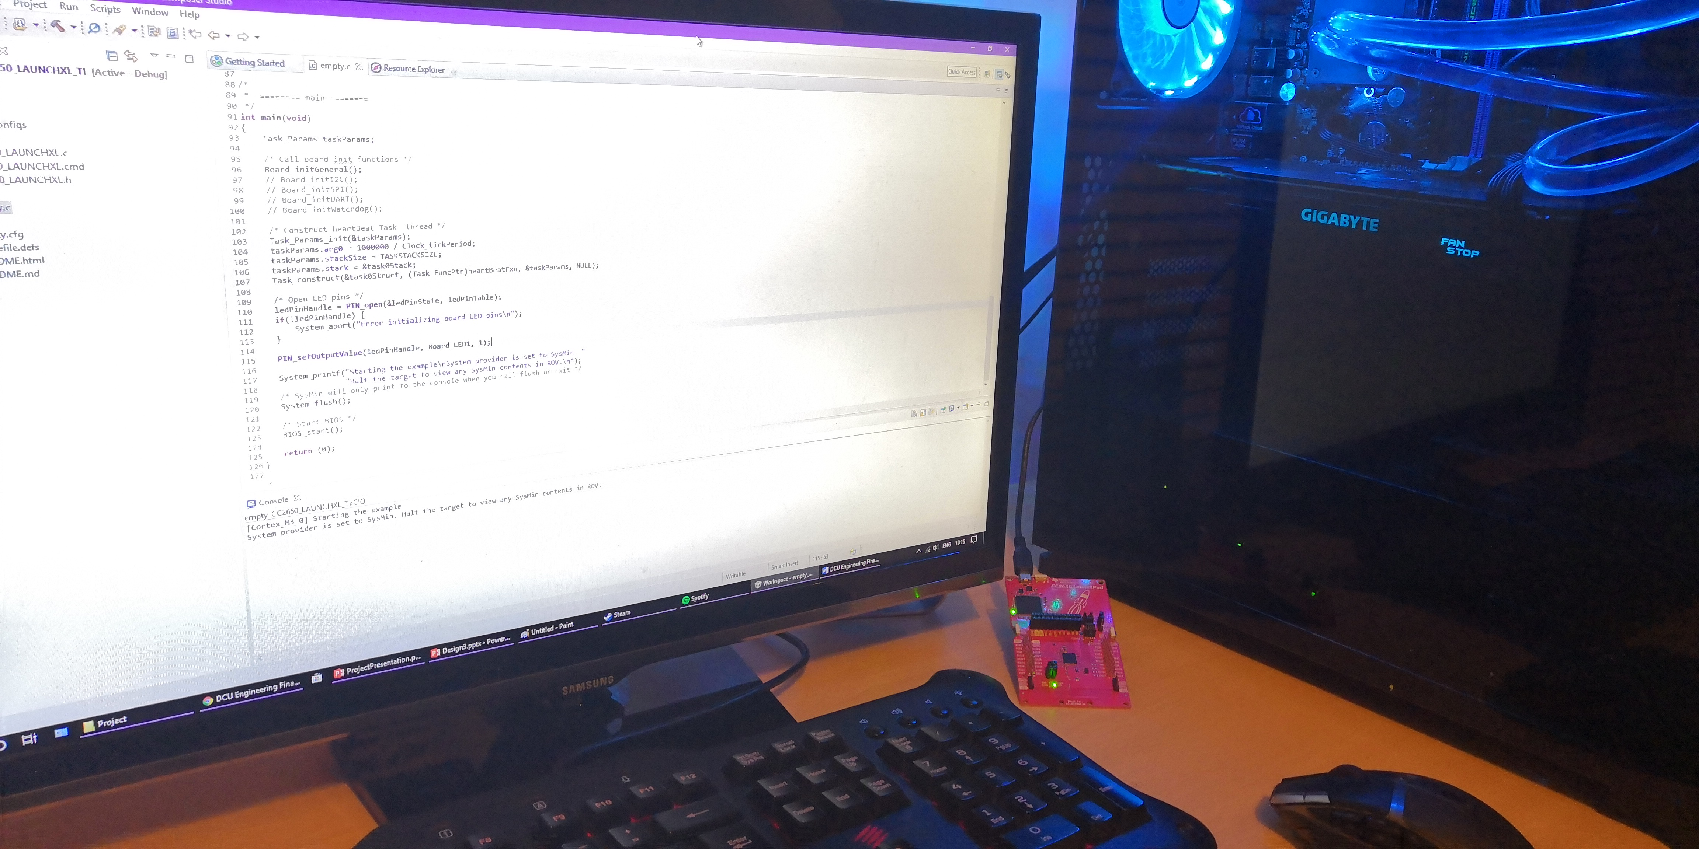
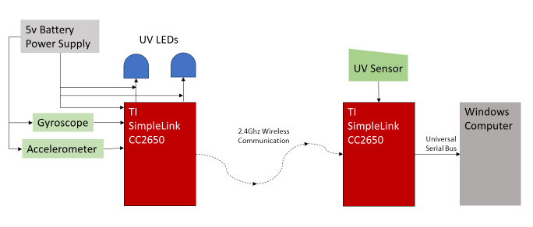
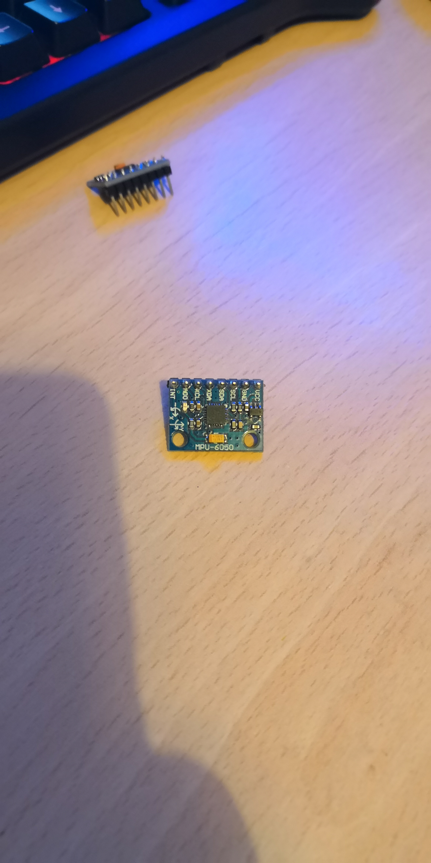
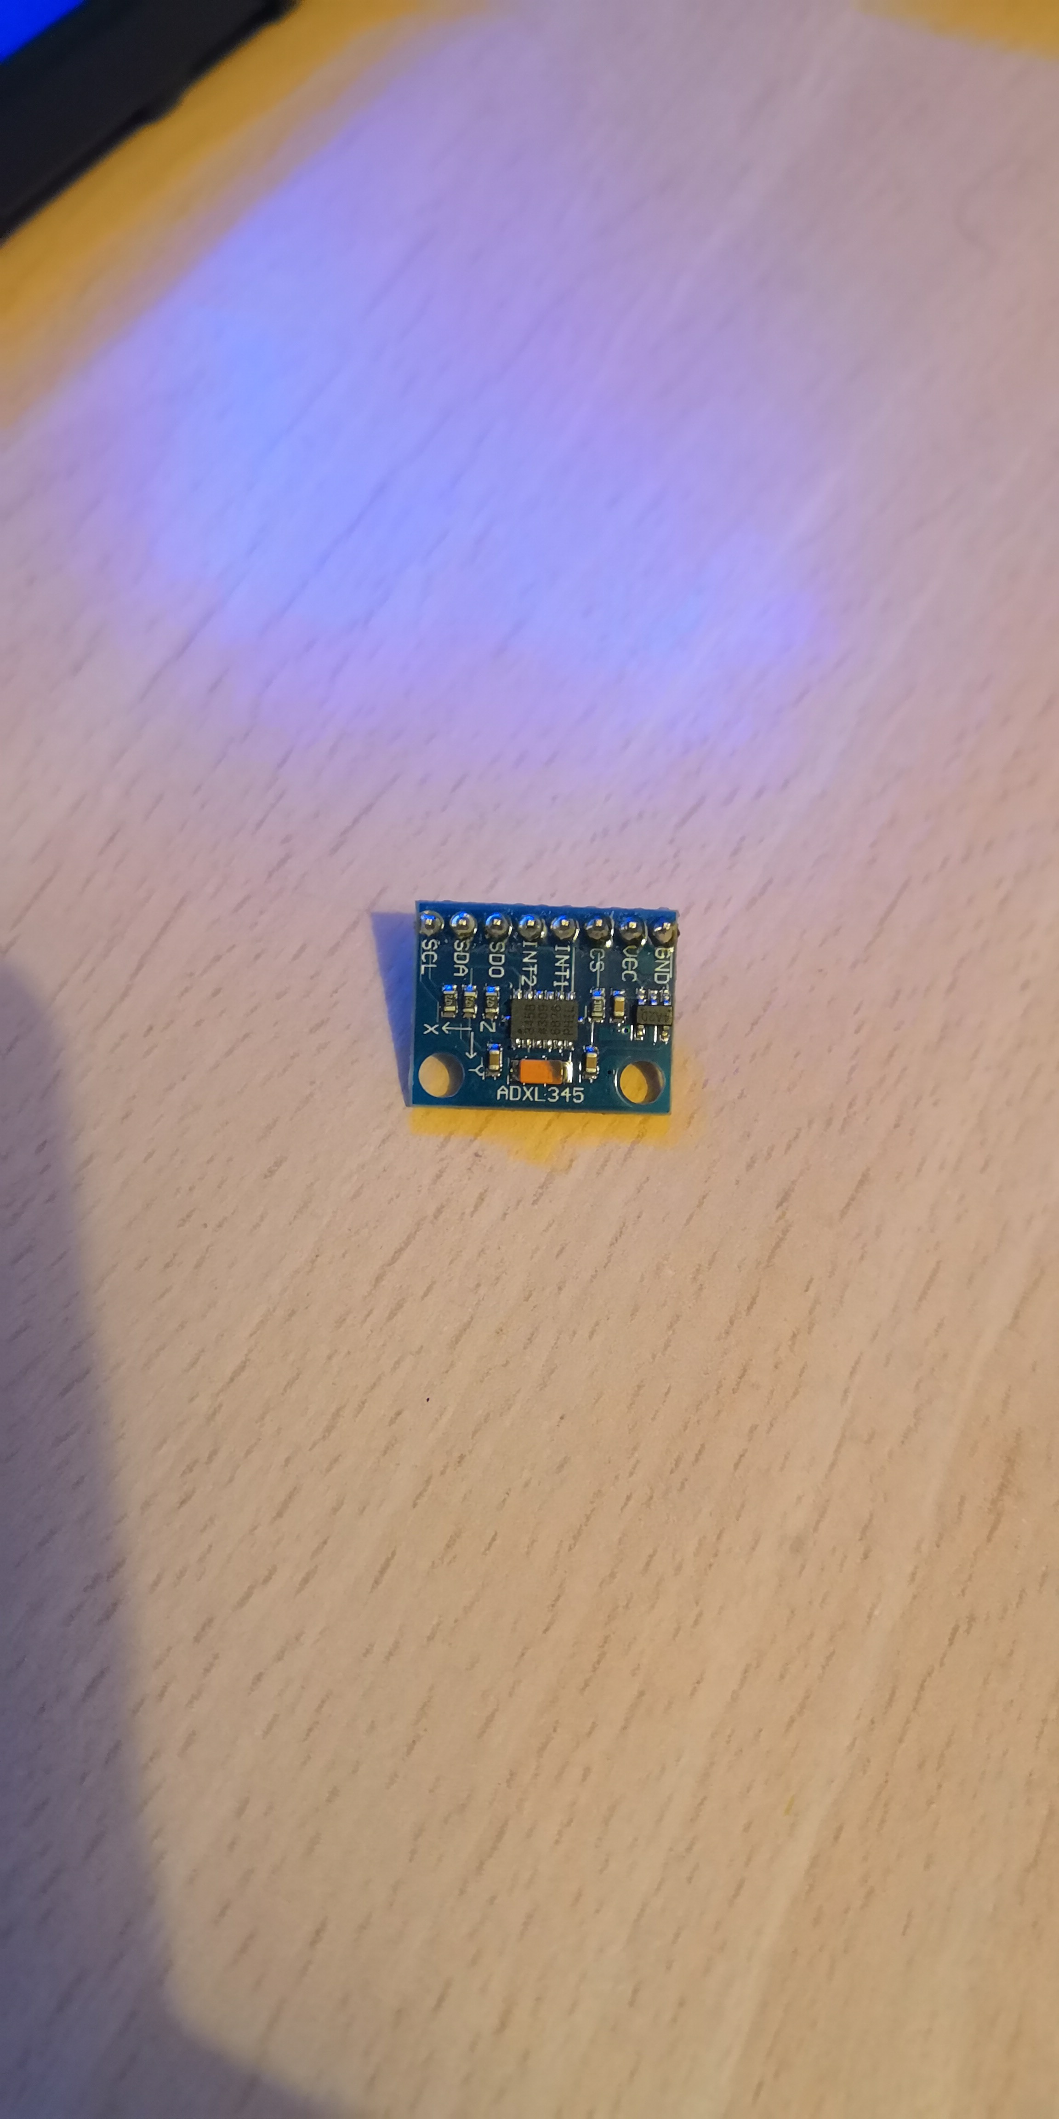
Design So Far
Some initial test code has been written for the device.
General Design for device:
Modular nature allows design to change throughout project.
Initial parts selection:
System Gyro Accelerometer
TI cc2650 MPU-6050 ADXL345

Slide 10
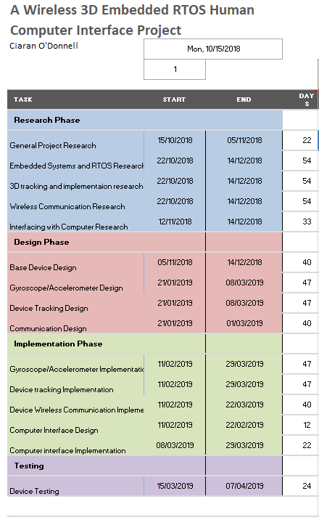
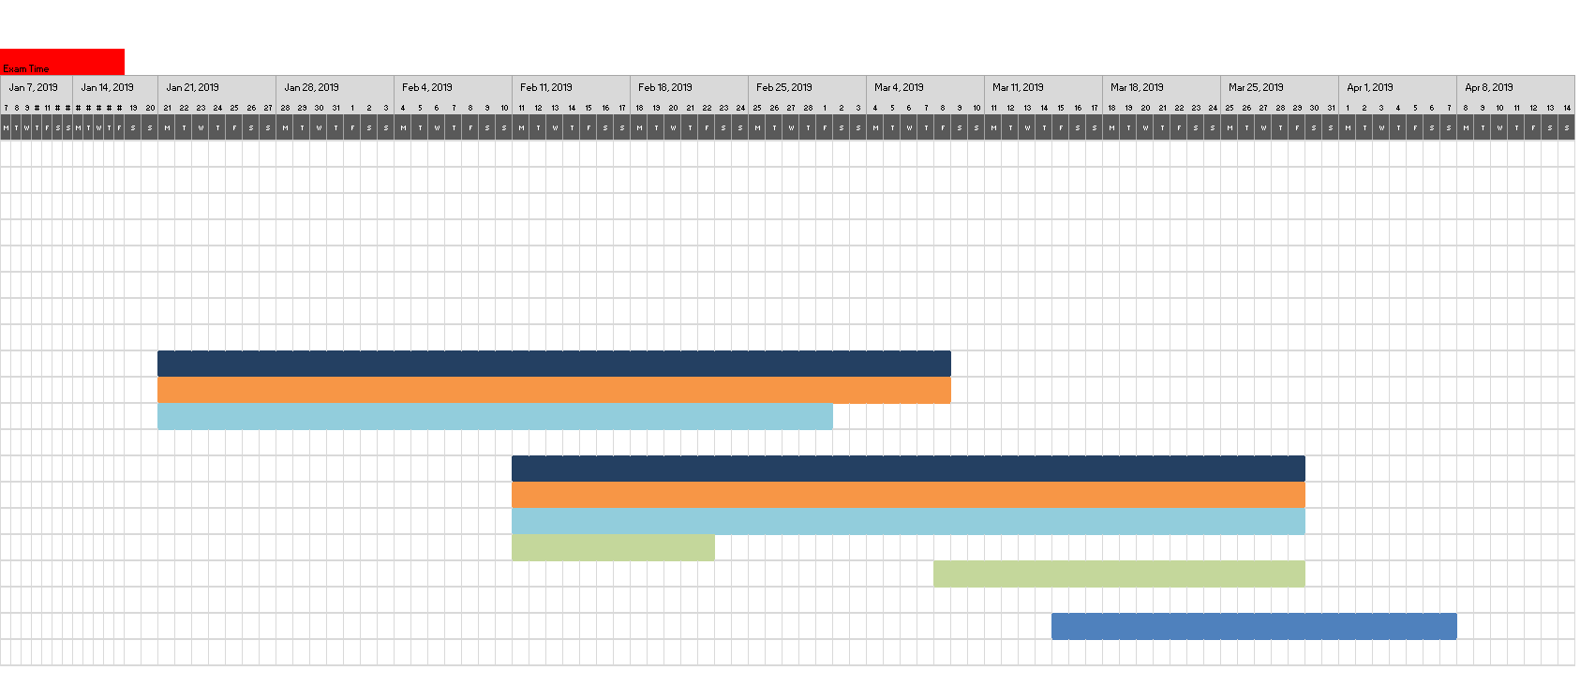
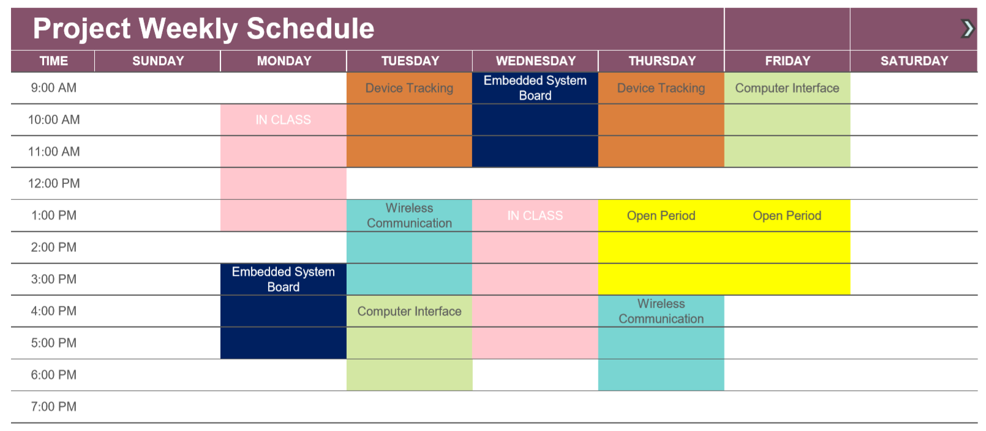
Project Plan/Schedule
The project weekly schedule:
The project weekly schedule:

Slide 11
Thank you for listening!
References:
[1] | J. Pfaff, "Wikimedia.org," 21 July 2010. [Online]. Available: https://commons.wikimedia.org/wiki/File:KinectSensor.png. [Accessed 31 January 2019].
[2] | A. Case, "flickr.com," 13 October 2017. [Online]. Available: https://www.flickr.com/photos/caseorganic/37005641863. [Accessed 31 January 2019].
[3] | Unknown, "Pixabay.com," [Online]. Available: https://pixabay.com/en/wii-controller-computer-152197/. [Accessed 31 January 2019].
[4] | LucasVB, "Wikimedia.org," 4 October 2006. [Online]. Available: https://commons.wikimedia.org/wiki/File:3D_Gyroscope-no_text.png. [Accessed 31 January 2019].

